Slide 1
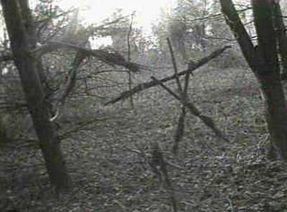
All Work and No Play: The Horror Genre

Slide 2
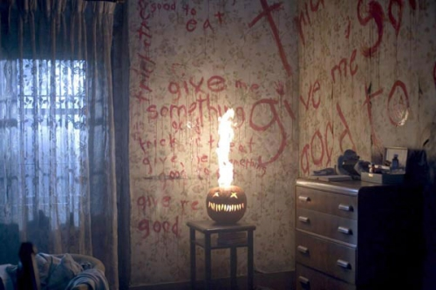
What we will do…
Learn about the codes and conventions (rules) of the horror film.
Look at an example of a contemporary horror film.
Create a horror movie trailer using the codes and conventions.

Slide 3
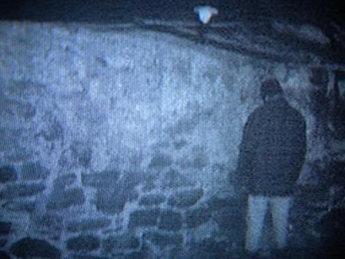
Why Study Horror?
It is the one of the oldest genres of movies and little has changed with the basic structure of the horror film.
Creating a horror film requires not only thought about the plot, setting, and characters, but also forces you to think about the visual and audio aspects.

Slide 4
1920s

Slide 5
1960s

Slide 6
1980s

Slide 7
2000s

Slide 8
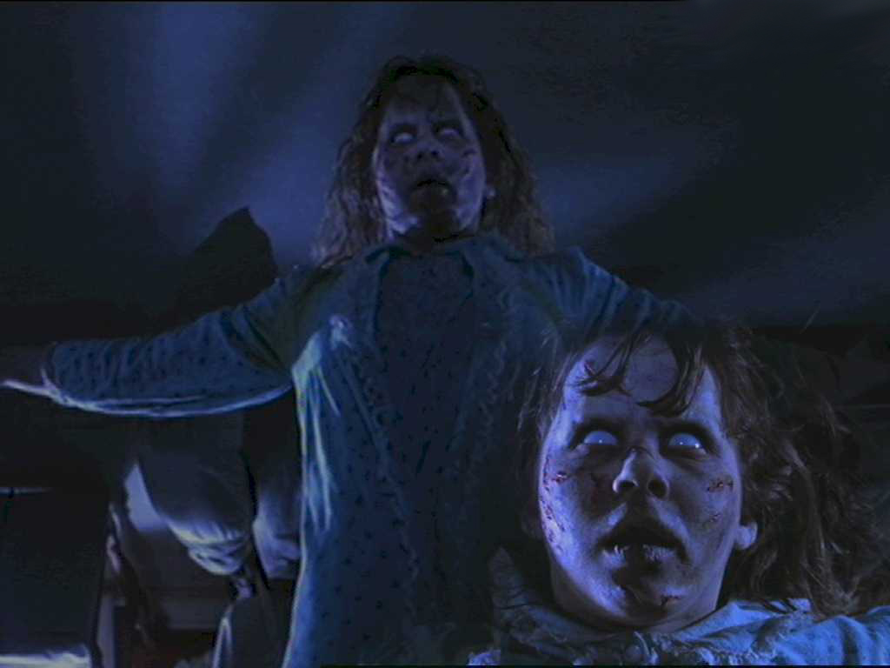
The Process…
Study the horror genre, learn its codes and conventions
Log on to the group page,
and explore the “Horror
Genre Study Guide.” You
will need to visit the
Media Studies Website
(address on study guide)

Slide 9
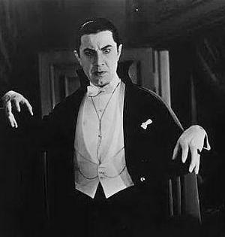
2. Watch an example of a contemporary horror film--Something by Stephen King—he may not be the “scariest” in terms of blood, guts, crazy axe-wielding psycho-killers, but he is a master of psychological suspense and horror

Slide 10
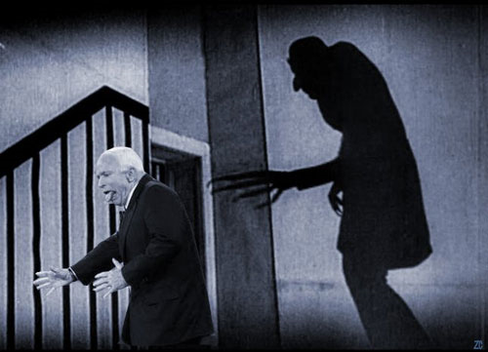
3. Create an outline for your own horror movie. (No we will not be filming the entire movie), paying particular attention to the codes and conventions of the genre. You will also create a storyboard

Slide 11
4. From your story idea, you will decide how to capture the essence of your film in a 3-4 minute trailer.

Slide 12
The Rules
Safety is your first priority
These are not blood and guts horror movies—gratuitous violence is not acceptable. Think psychological fear rather than purely physical fear.
You may recruit outside help if you wish, but you are strongly encouraged to choose your partners wisely.
You will be graded on each of the steps. A detailed rubric for the trailer will be handed out as we get closer to the filming.

